Slide 1
Online Car Dealer System
Rogelio Alonso
Ariel Cambas
Johann Henao
Yang Zhang

Slide 2
Brief Introduction
Our client "Sunshine Car Dealer Inc." is in the business of selling cars. They want to extend their business model to include an online car sales system that they wish to call "Sunshine Online Car Dealer System".
The purpose of having an online car dealer system for Sunshine Car Dealer are as follows:
Stay competitive
Different purchasing experience
Cut down expenses
Consolidate Inventory

Slide 3
Nonfunctional requirements
Usability
The Sunshine Online Car Dealer System will be available at all times and accessible from any computer connected to the internet with a browser.
Reliability
The system will be a secure reliable source to make a vehicle purchase.
The Sunshine Online Car Dealer System will not have an invalid input as all the input option will be provided for their selection.
The Sunshine Online Car Dealer System will only provide for sale whatever is available in it’s inventory.
Performance
There is no constrain on response time.
Supportability
Very portable since every device (i.e.: Smartphone or Tablet) with a browser will be able to access the Sunshine Online Car Dealer System .
The Sunshine Online Car Dealer System has been designed with Entity, Boundary and Control objects making the system more adaptable to maintainability, changes and support.

Slide 4
Functional Requirements
1- The system shall have a function to search cars from the available car inventory. The search criteria will be through selectable values, no free format input from the user.
2 – The system shall have a function to route a user to register or login.
3 - The system shall display the search result (from requirement 1) with the basic car information.
4 - The system shall allow the user to request a more detailed car information per car within the search results from functional requirement 3, which will return a page with pictures of the car, basic car information and additional notes.
5 - The system shall have a function to purchase a car. To purchase a car, a user must be registered and logged in.
6 – The system shall allow a user to register and/or login.
7 – The system shall allow a user to reset the login password in case it is forgotten.
8 – The system shall display an order confirmation after the user submits the payment information.
9 - The system shall allow the user to update its profile information.
10 – The system shall provide and administration portal.
11 – The system shall allow the creation of additional administrators.
12 – The system shall allow the administrator to view/edit/delete all registered users.
13 – The system shall allow the administrator to view/edit/delete the car inventory.
14 – The system shall allow the administrator to generate a sales report in a valid date range.

Slide 5
Constraints
The systems interface must be any web browser.
Sunshine Online Car Dealer System must contain a mySQL database with at least one user as Administrator.
It will assign a session to every user accessing a domain web page.
It has to be capable to support three types of user (Guest, Customer & Admin)
The Sunshine Online Car Dealer System will sell cars with minimal human supervision.
The system will sell 1 car a time.

Slide 6
Selected Use Case 1
Name: Login
Actor: User/Admin
Entry Condition:
User/Admin must be at the login web page of Sunshine Online Car Dealer System.
User/Admin has a valid username and password.
Event Flow:
User/Admin input username and password into the Login web page.
Sunshine Online Car Dealer System match username/password entered with list of stored users/admin.
Sunshine Online Car Dealer System logs User/Admin into the system.
User/Admin are redirected to home/index web page or into the requested page showing a logged in status.
Exit Condition: User/Admin is logged into Sunshine Online Car Dealer System.
Exceptions:
Cancel
“Wrong Username/Password”
“No connectivity”

Slide 7
Selected Use Case 2
Name: Purchase A Car
Actor: User
Entry Condition:
User must be at a web page of Sunshine Online Car Dealer System displaying a list of cars.
User must be logged in.
Event Flow:
User selects car to be purchased.
Sunshine Online Car Dealer System displays the car details including price.
User selects Purchase option.
User enters the credit card information to purchase the selected car.
Sunshine Online Car Dealer System shows a confirmation web page with transaction details and delivery date.
Exit Condition: User purchased a car.
Exceptions:
Cancel
Invalid Credit Card Information
Sold to another faster customer

Slide 8
Selected Use Case 3
Name: Add Admin
Actor: Admin
Entry Condition:
Logged in as admin
On the page with the “Add Admin” function
Event Flow:
Admin choose to do the “Add Admin”
Enter the information of the new admin that needs to be added
Submit it to create the new admin
Exit Condition: A new admin user is created in the system.
Exceptions:
Cancel
“Username already exists”

Slide 9
Selected Use Case 4
Name: Edit Cars
Actor: Admin
Entry Condition:
Logged in as admin
On the page with the “Edit Cars” function
Event Flow:
Admin choose to do “Edit Cars”
Edit the information of the cars in the inventory
Submit to update the car’s information
Exit Condition: Admin updated a car information.
Exceptions:
Cancel
Repeated Unique values

Slide 10
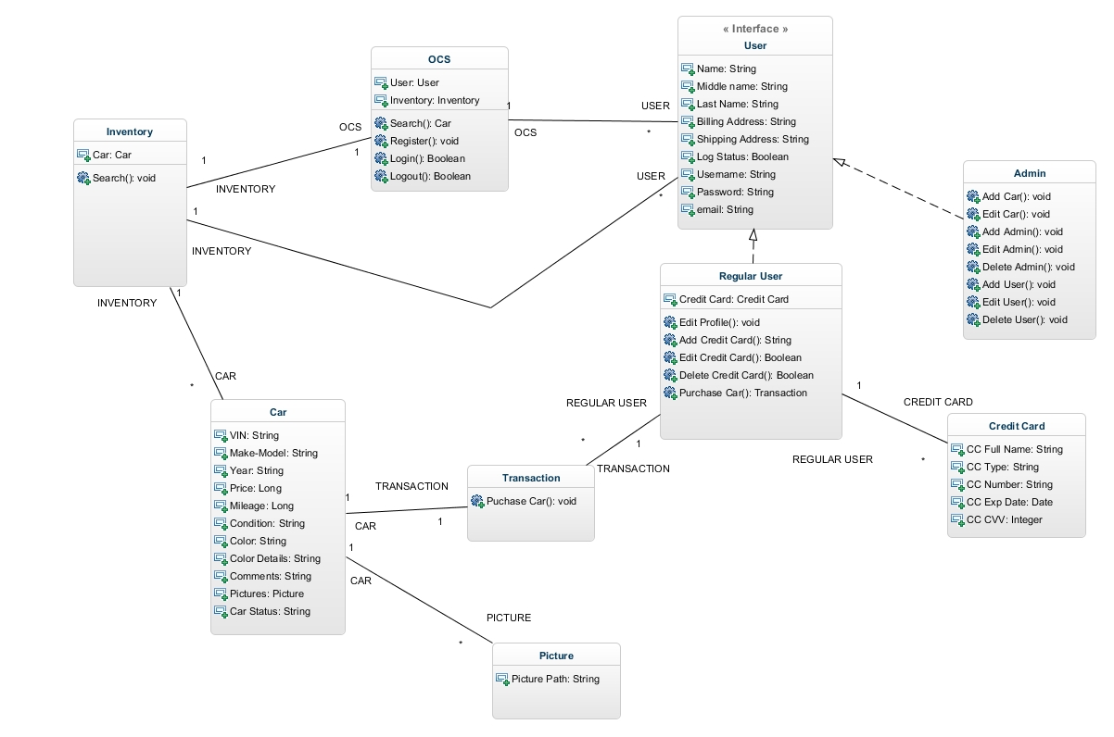
Class Diagrams

Slide 11
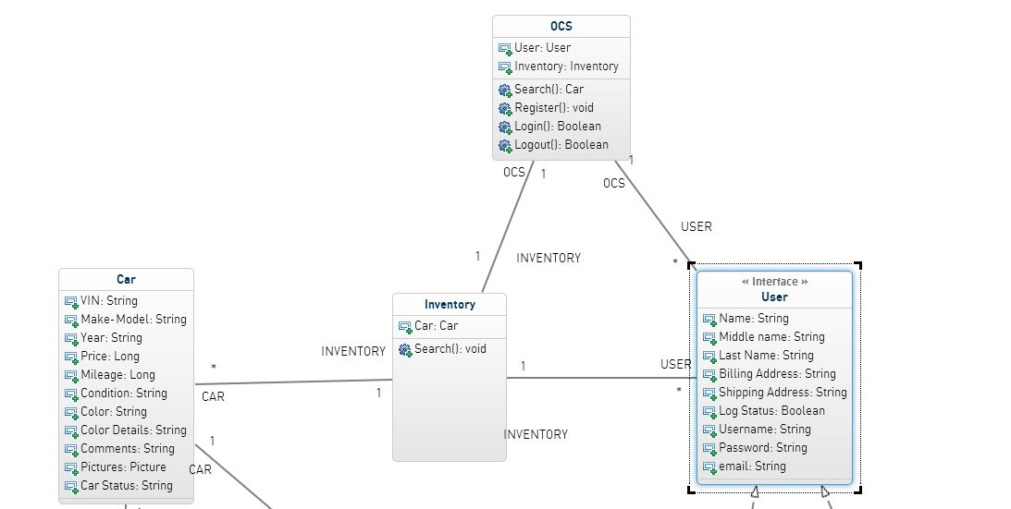
Class Diagrams

Slide 12
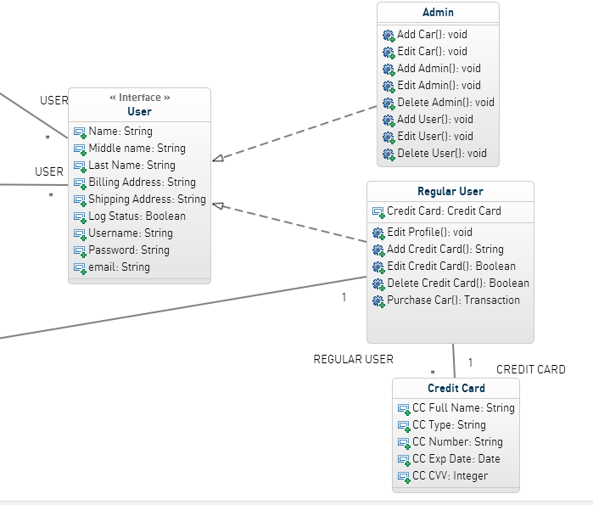
Class Diagrams

Slide 13
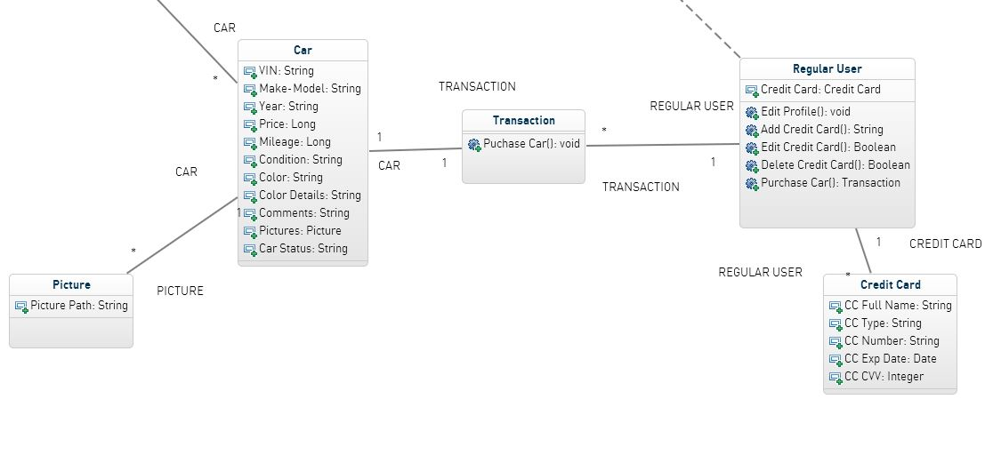
Class Diagrams

Slide 14
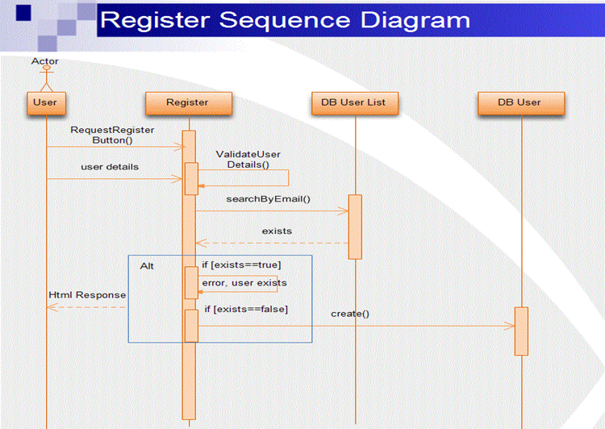
Selected Sequence Diagram 1

Slide 15
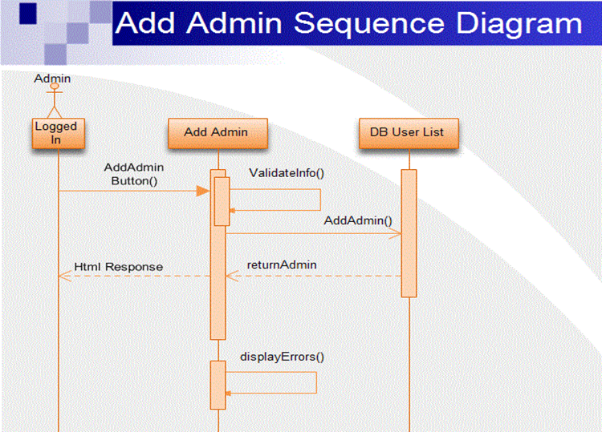
Selected Sequence Diagram 2

Slide 16
Summary
Provide a tool for Sunshine Online Car Dealer System to stay competitive
Functional and Non-Functional requirements
Examples of Uses Cases
Constrains
Object Model
Dynamic Model
Questions?

